Slide 1
University Alliance
The voice of professional and technical universities

Slide 2

Introducing
University
Alliance
Notes:
Have you heard of the Russell Group? (Could ask for a show of hands here)
Well, it might surprise you to know that the Russell Group is not the only group of universities in the UK.
Each group of universities stand for something slightly different, so you can tell a lot about a university from which group it’s part of.
Today I’m going to talk to you about University Alliance – a group of the UK’s leading professional and technical universities – and don’t worry, I’ll explain a bit about what that means in a minute.

Slide 3
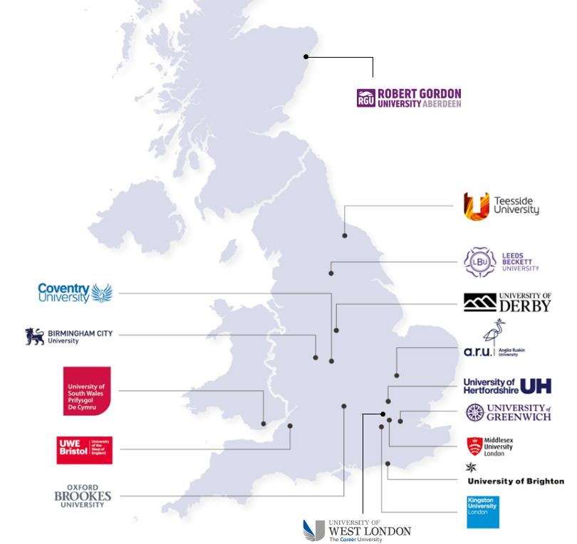
Alliance universities
Leading professional and technical universities
Anglia Ruskin University
University of Brighton
Birmingham City University
Coventry University
University of Derby
University of Greenwich
University of Hertfordshire
Kingston University
Leeds Beckett University
Middlesex University
Oxford Brookes University
Robert Gordon University
Teesside University
University of South Wales
UWE Bristol
University of West London
Notes:
There are 16 universities in the University Alliance
Alliance universities are based all over the UK, as you can see here.

Slide 4



What is a professional and technical university?
Industry
Innovation
Community
Notes:
There are three things that Alliance universities really specialise in:
Industry: the main thing you need to know about professional and technical universities like those in University Alliance is that we specialise in working with industry and employers. That means you can expect a course at an Alliance university to be quite practical and informed by industry practice.
Innovation: because of our partnerships with employers, our universities are constantly reviewing the way we teach and the research we do to make sure we are not just keeping up with industry but are shaping new technologies and working practices. That means that you can expect some innovative teaching and facilities at Alliance universities.
Community: Alliance universities work really hard to develop vibrant communities, both on our campuses but also in our local areas. That means we don’t just work with big employers, but we also help small local businesses to start up and support local charities and community groups.

Slide 5



What does this look like for students?
Applied and practical learning and assessment.
Students learn from and with employers through industry placements, live projects and teachers with industry backgrounds.
Students use the best and most up-to-date facilities and equipment.
Notes:
In practice, what this means for students is:
their courses often include practical teaching and assessment options
opportunities to learn from employers through work placements, projects set by employers and teaching from industry professionals
Opportunities to use the most up-to-date facilities and equipment
You might think this sounds like our courses are mostly for science and engineering students, but that’s not the case. Arts and humanities courses at Alliance universities also often include employer contact – as an English student, for example, you might have the opportunity to work on professional marketing projects

Slide 6


University Alliance: Facts & Stats
16
University Alliance currently hold more
gold Teaching Excellence awards per member than any other university group
Biggest subject areas:
Healthcare
Engineering
Social sciences
Creative arts
Business and computing
of the UK’s world-leading professional and
technical universities
67%
95%
93%
of Alliance graduates are in jobs or an activity like further study just 15 months after graduation, and…
of those described their work as meaningful.
of our members’ research is world leading or internationally excellent
Notes:
Why do University Alliance describe themselves as a group of ‘leading’ professional and technical universities? Well – in order to join the University Alliance, any university has to demonstrate that they meet a set of requirements. There are measures of how involved they are with employers and their local communities, as well as quality measures – how well they score in the government’s Teaching Excellence Framework, for example, or how good their student feedback is.
As a result of these requirements, University Alliance universities are the most likely group to be ranked gold for teaching quality by the government (yes, more than the Russell Group!). To determine those rankings the government combines student feedback, graduate employability measures and a detailed look at each university’s approach to teaching.
95% of graduates from Alliance universities were in work or another activity like further study within just 15 months of graduating – and 93% of those described their work as meaningful, so graduates do go on to work that they find fulfilling.
Alliance universities offer a whole range of courses and their biggest subject areas are: Healthcare, engineering, social sciences, creative arts, business and computing

Slide 7

































Alliance alumni
Notes:
Here are just a few people who studied at Alliance universities. Do you recognise any of them? [Could encourage students to point out people they recognise]

Slide 8

What do students and graduates say?
Notes:
The next few slides are stories from students who have studied at Alliance universities – I’ll go through and just pause on each one, so you have a chance to read what they say about their experience.

Slide 9


What do students and graduates say about Alliance Universities?
The lecturers were world-class, active astronomers, so each class was dynamic to the ever-changing knowledge of their respective fields of research. Their willingness to accept keen students for extracurricular research projects gave me early first-hand experience of the career I was about to launch myself into.
Dr. Samuel Nathan Richards
Studied: Astrophysics, University of Hertfordshire
Job: Mission Director & Instrument Scientist, NASA

Slide 10

What do students and graduates say about Alliance Universities?
The lecturers are so experienced, as they’re all actively working in the industry and have been for years. Developing my expertise directly from industry specialists has been vital. Also, the equipment we have access to is top-notch. The cameras, lighting, microphones – the tech is amazing, and that’s made a massive difference to my storytelling. The partnership the course has with the BBC is incredible.
MA Wildlife Filmmaking, UWE Bristol

Slide 11


What do students and graduates say about Alliance Universities?
During my time at BCU, I did an internship with Huffpost UK, where I worked in their newsroom for seven weeks. I also did a few weeks in marketing at Jewellery Quarter BID, which gave me skills to write for a specific audiences. I was able to do an internship at the Graduate+ office at BCU, which gave me an insight into social media, as well as a placement at the Shropshire Star, which allowed me to discover my love for local journalism.
Anisah Vasta
Studied: English and Journalism, Birmingham City University
Job: Journalist, Birmingham Live

Slide 12

A changing world: the future of work
Notes:
When considering university, you’re likely to be thinking about your future career as well, and how to choose a degree that will get you to where you want to go. In a minute, I will talk a bit about how Alliance universities can support your career, but first, I thought it would be helpful to share some insights about what employers are looking for when they hire graduates.

Slide 13
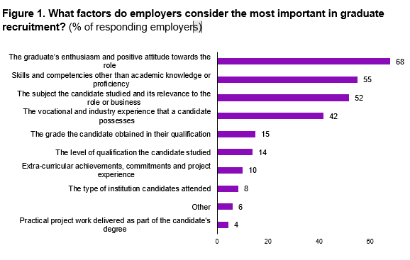

What employers look for is changing
“20 years ago, where you went to university was really important, now where you've been is less important than how you present yourself.”
Business representative, Public Sector
“I think (where you studied) is less of an issue now. It’s more to do with what you’ve studied and how adaptable that is to workplace learning.”
Business representative, Advanced Technology
“The [Alliance Universities] I know are very good at the industry partner ingredient”
Business Representative, Law
Notes:
The main thing to note is that what employers look for is changing – they are much less likely now to look for graduates from historic and well-known universities, and much more likely to look for graduates with the specific skills they need.
On the right hand of this slide you can see some quotes from employers that University Alliance spoke to as part of a piece of research they did, and on the left hand side is a graph showing what employers say are the most important factors they consider when hiring graduates. This is taken from a study that was done by CBI Economics.
You might find the graph a bit tricky to read, but what it shows is that the top four things employers look at are:
A graduate’s enthusiasm for the job
Specific skills they have developed beyond their academic skills (the study identifies things like people skills and problem solving skills, for example)
Whether or not their degree is in a relevant subject
Whether they have had any vocational or industry experience as part of our alongside their degree.

Slide 14
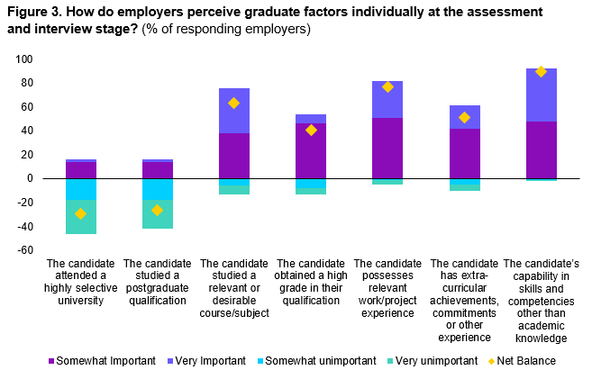
What employers look for is changing
Notes:
This graph is from the same study and shows a similar thing in a slightly different way – it ranks various factors according to how important employers said they were
You can see on the left-hand side of the graph that whether or not a candidate attended a highly selective university was very unimportant, whereas those skills that go beyond academic skills – problem solving etc, are extremely important indeed

Slide 15
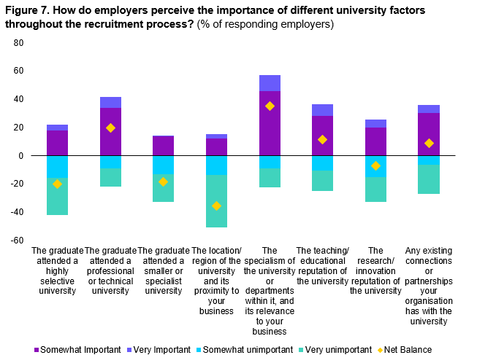
What employers look for is changing
Notes:
Finally, CBI Economics asked employers if they did have a preference for a certain type of university, which they would choose
Now, remember that for most employers, the university you go to doesn’t matter at all...
…But, when asked to choose a preferred type, employers were most likely to pick ‘universities that specialise in relevant subjects’, followed by ‘professional and technical universities’ – like those in the University Alliance

Slide 16



What do employers say about Alliance Universities?
“I have been personally bowled over by the quality of students at the University of Hertfordshire. We are super proud to be supporting the university and the work they do.”
James Darley
CEO, Transform Society
“Lloyds Banking Group has built a robust relationship with UWE Bristol, engaging with lecturers and course leaders to deliver sessions to students studying banking and finance. This not only helps individuals realise their ambitions but helps UK businesses.”
Caron Ricciardi
Lloyds Banking Group
“Our partnership with the University of South Wales allows us to access talented graduates to work across departments and directly on productions at Wolf Studio Wales. We’ve taken on several graduates in animation, design and computing to work on our productions.”
Allison Dowzell
Screen Alliance Wales
Notes:
- Here are a few comments employers have made about Alliance universities specifically

Slide 17

The UA way: Embedded employability
Notes:
One of the reasons Alliance universities are popular with employers, as well as scoring highly for teaching excellence is because of the way we embed employability in their courses, making them engaging for students while also helping develop those skills that employers are really looking for
Let’s take a look at what embedded employability looks like in practice

Slide 18

1. Courses co-designed with industry
Example:
At Middlesex University, the Film School created the ‘Creative Campus Network’: a partnership between academics and employers in the film industry, which informs curriculum development and ensures students graduate with the exact skills industry are looking for.
Notes:
Use text on slide as prompt

Slide 19

2. Built-in opportunities to engage with employers
Example:
At Anglia Ruskin University, every undergraduate student has the opportunity to work on a ‘Live Brief’ project: a real-world project commissioned by an employer. Examples include English students being commissioned to work on marketing projects, and students studying environmental sciences delivering projects for Natural England.
Notes:
Use text on slide as prompt

Slide 20
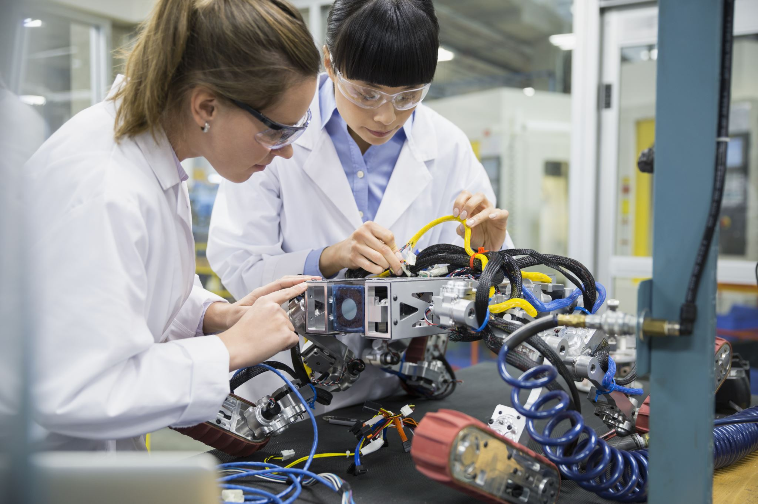
3. Using industry standard facilities (or better!)
Example:
The Bristol Robotics Laboratory at UWE Bristol is at the forefront of developing new robotics technologies, including driverless cars. Students at the university have access to the facilities where these technological developments are taking place.
Notes:
Use text on slide as prompt

Slide 21

4. Employability skills as part of the curriculum
Example:
As part of Kingston University’s ‘Future Skills’ programme, employability modules are embedded in every undergraduate course and are taken by every student. The skills they develop during the modules are based on an extensive study of the skills employers are looking for.
Notes:
Use text on slide as prompt

Slide 22

Questions to discuss

Slide 23

Questions to discuss
How do you like to learn? Do you prefer lots of reading and writing? Lots of practical and group work?
Do you know what you’d like to do as a career?
How interested are you in research in your subject area, and how interested are you in understanding the industries you may work in?
What sort of university community are you interested in?
Notes:
There are lots of things to consider when choosing a university, and these are some of the things we would recommend thinking about. Remember that you will spend a number of years at your university, and you want to make sure that the teaching inspires and motivates you to do your absolute best. So, think about how you like to learn, who you’d like to learn from and the sort of environment you want to learn in.
[Option to conduct group exercise to discuss questions]

Slide 24

The essentials
Notes:
Before we go, I’m going to share the essential information you need if you think you’d like to apply for an Alliance university.

Slide 25
The essentials
A levels
T levels
BTECS
International Baccalaureate
…and more.
What qualifications do Alliance Universities accept?
Notes:
Use text on slide as prompt

Slide 26
The essentials
Usual UCAS application process
Most courses use the equal consideration deadline (July deadline and clearing also possible)
Degree apprenticeship applications go through employers
How can students apply for a professional and technical university?
Notes:
Use text on slide as prompt

Slide 27
The essentials
unialliance.ac.uk
Email: info@unialliance.ac.uk
Where can we go for more information?
Notes:
Use text on slide as prompt

Slide 28

Thanks for listening

